Slide 1
C++ review

Slide 2
Outline
Reminders & Rules
C++ and STL
Brief intro to C++
STL (read reference, iterator, vector, string)
Recursion
Review: Fibonacci Sequence
Merge Sort

Slide 3
Reminders
C++ will be used in this course
Slides, demo will be in C++
We only reply problems with C++
Online judge accepts C++ / C / python3
We only guarantee problems can be solved with C++
Since we don’t have much time, we won’t use OOP for C++
No classes, no inheritance
Although it is highly important in practice
If you need direct assistance, please come to lab
Plagiarism is definitely not tolerated!!!

Slide 4
Rules -- Public Discussion
Lectures, labs, coding assignments problems
Post them publicly on eeclass discussion board
DO NOT send private emails to TAs to ask about lectures, labs, coding, we ignores them
Private issues (e.g. positive COVID-19 tests, grades)
Send and cc (副本) to all of us to avoid email miss
Prof. Hon: wkhon@cs.nthu.edu.tw
TA Xavier: xavier230505@gmail.com
TA Chchiang: timmychiang0506@gmail.com
TA Charlie: charlie565788@gmail.com
If you are competent to answer classmate’s question, Don’t be shy!

Slide 5
Rules -- Coding Problems
Please use natural human language to explain your thoughts
Please add comments in your codes
Please name the variables properly
Please paste codes through sites that supports indent and highlights
codepad.org
gist.github.com
Ideone
DO NOT printscreen, take pictures of your screen, paste raw codes on eeclass
TA may refuse to help if your paste is harmful or hostile to us

Slide 6
Online Judge
140.114.77.113
please register an account, use student id as username
log in the account
settings -> profile: please fill in your real name (your score depends on it)
If you forgot your password or username, please email TAs directly with proper proof of who you are.

Slide 7
C++ and STL Intro

Slide 8
Brief Review on C++: reference (參照)
void swap(int &a, int &b) {
int tmp = a;
a = b, b = tmp;
}
int main() {
int a = 487, b = 63;
swap(a, b); // a == 63, b == 487
}

Slide 9
Brief Review on C++: reference (參照)
int upper_bound(vector<int> &arr, int n, int val) {
int l = 0, r = n-1, mid, ret = -1
while (l <= r) {
mid = (l+r)/2;
if (arr[mid] > val) ret = mid, r = mid-1;
else l = mid+1;
}
return ret;
}

Slide 10
Brief Review on C++: STL
C++ STL (standard library) provides a wide range of containers and algorithms
Reference: https://en.cppreference.com/w/
Containers:
std::vector
std::string
std::set
std::queue
…
Algorithms:
std::sort
std::binary_search
std::lower_bound
std::upper_bound
…

Slide 11
Brief Review on C++: STL
When using STL, please notice:
Template parameters
Constructors (STL container only)
Function parameters
Return type
Time complexity

Slide 12
Iterator
Day 3 - Iterators
begin()
end()
0 | 1 | 2 | 3 | 4 | 5 | 6 | 7 | 8 | 9 | 10
arr[0] | arr[1] | arr[2] | arr[3] | arr[4] | arr[5] | arr[6] | arr[7] | arr[8] | arr[9]
int main() {
vector<int> arr(10, 0);
vector<int>::iterator L = arr.begin();
vector<int>::iterator R = arr.end();
}

Slide 13
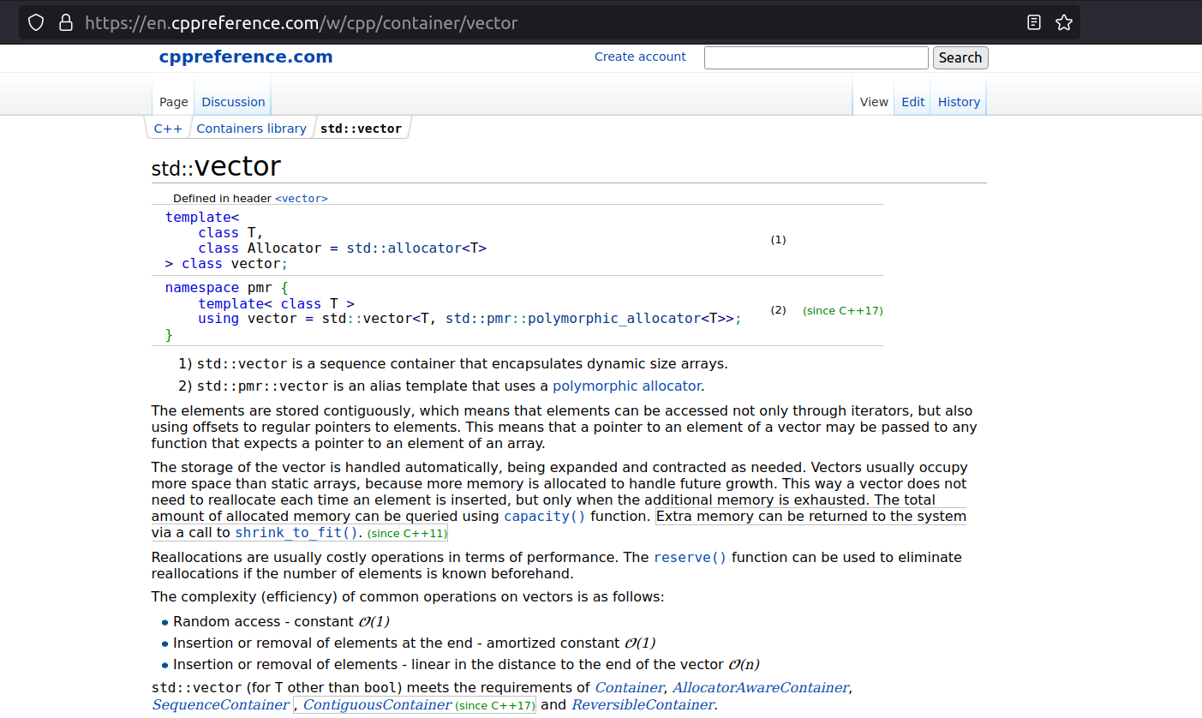
std::vector @
A dynamic array

Slide 14
std::vector
begin()
end()
Variable size array
O(1) insert/delete element in the back
O(n) insert/delete arbitrary element
O(1) random access
index | 0 | 1 | … | size-1 | size
vector<int> arr(100, 0);
arr.emplace_back(87);
arr.pop_back();
arr[12] = 34;
sort(arr.bgn(), arr.end());

Slide 15
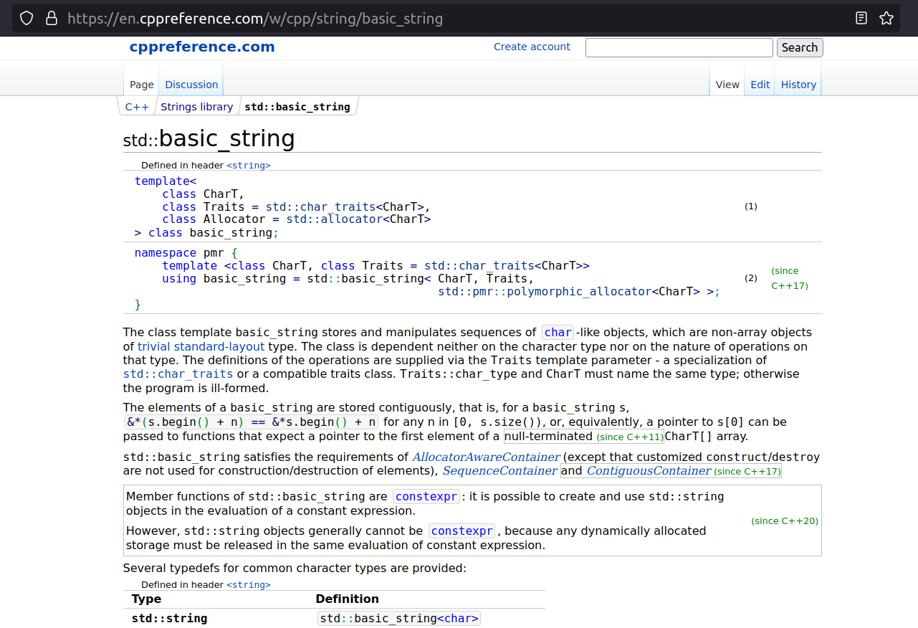
std::string @

Slide 16
std::string
C++ STL 提供的字串類別比傳統的 char[] 方便許多
string str = "I_am";
str += "_string";
str[1] = str[4] = ' ';
cout << str; // "I am string"
begin()
end()
0 | 1 | 2 | 3 | 4 | 5 | 6 | 7 | 8 | 9 | 10 | 11
I |  | a | m |  | s | t | r | i | n | g
*不是用 ‘\0’ 當結尾

Slide 17
struct / std::pair / std::tuple
e.g. Representing a 2D-coordinate?
// arrays
int x[10], y[10];
x[0] = 1;
y[0] = 1;
// std::pair
pair<int,int> arr[10];
arr[0].first = 1;
arr[0].second = 2;
// struct or class
struct Point { int x, y; };
Point arr[10];
arr[0].x = 1;
arr[0].y = 2;
// std::tuple
tuple<int,int> arr[10];
get<0>(arr[0]) = 1;
get<1>(arr[0]) = 2;

Slide 18
Typename Alias、auto
Replace lengthy type name with using-declaration
Increase readability with “auto”
using Iter = vector<int>::iterator;
vector<int> arr(487, 63);
vector<int>::iterator it1 = arr.begin();
Iter it2 = arr.begin();
auto it3 = arr.begin(); // c++11
tuple<int,int,int> point3D;
auto &[x, y, z] = point3D; // c++17

Slide 19
Range Based For (C++11, C++17 or later)
vector<int> arr(487, 63);
for (auto &x : arr) {
cout << x << "\n";
}
map<int,int> mp;
for (auto &[key, val] : mp) {
cout << key << "," << val << "\n";
}

Slide 20
Learning Resources
C++ Language
https://en.cppreference.com/w/
https://cplusplus.com/reference/
<<A tour of C++>> (@)
Algorithm & Data Structures
<<Introduction to Algorithms>>
<<Fundamentals of Data Structures in C++>>
Most of them are beyond the scope of this course :)

Slide 21
Lab0
Self-testing
You should be able to solve at least 3 of them(normally Q1 < Q2 < Q3 < Q4 < Q5)
The deadline will be at 3/1, so there will be much time for you to solve these problem (or consider withdrawing).

Slide 22
Recursion

Slide 23
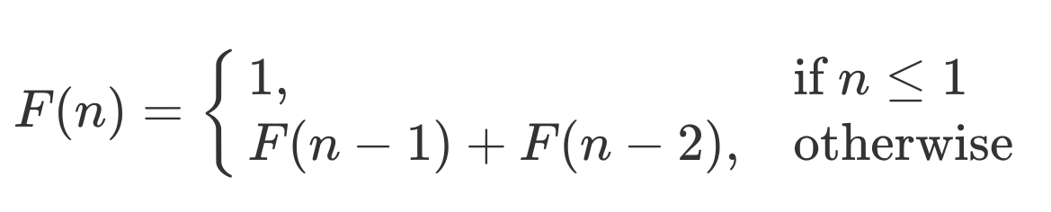
Fibonacci Sequence

Slide 24
Recursive Idea
大問題
小問題
很小的問題

Slide 25
遞迴心法
大問題
f(8763)
小問題
很小的問題

Slide 26
遞迴心法
大問題
f(8763)
小問題
f(8762), f(8761)
很小的問題

Slide 27
遞迴心法
大問題
f(8763)
小問題
f(8762), f(8761)
很小的問題
f(0) = 1, f(1) = 1,
f(2) = f(0) + f(1) = 2

Slide 28
遞迴心法
大問題
f(8763)
小問題
f(8762), f(8761)
問題規模變小
小問題跟大問題形狀類似
很小的問題
f(0) = 1, f(1) = 1,
f(2) = f(0) + f(1) = 2

Slide 29
程式上的遞迴
終止條件
int fib(int n) {
if (n <= 1)
return 1;
else
return fib(n-1) + fib(n-2);
}
遞迴

Slide 30
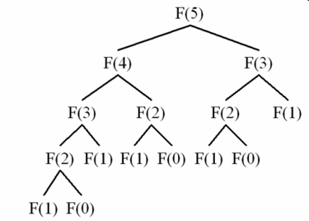
程式上的遞迴
fib(5) =
終止條件
int fib(int n) {
if (n <= 1)
return 1;
else
return fib(n-1) + fib(n-2);
}
遞迴

Slide 31
程式上的遞迴
fib(5) =
終止條件
int fib(int n) {
if (n <= 1)
return 1;
else
return fib(n-1) + fib(n-2);
}
遞迴

Slide 32
程式上的遞迴
fib(5) =
終止條件
int fib(int n) {
if (n <= 1)
return 1;
else
return fib(n-1) + fib(n-2);
}
遞迴

Slide 33
程式上的遞迴
fib(5) =
終止條件
int fib(int n) {
if (n <= 1)
return 1;
else
return fib(n-1) + fib(n-2);
}
遞迴

Slide 34
程式上的遞迴
fib(5) =
終止條件
int fib(int n) {
if (n <= 1)
return 1;
else
return fib(n-1) + fib(n-2);
}
遞迴

Slide 35
程式上的遞迴
fib(5) =
終止條件
int fib(int n) {
if (n <= 1)
return 1;
else
return fib(n-1) + fib(n-2);
}
遞迴
1

Slide 36
程式上的遞迴
fib(5) =
終止條件
int fib(int n) {
if (n <= 1)
return 1;
else
return fib(n-1) + fib(n-2);
}
遞迴
1
1

Slide 37
程式上的遞迴
fib(5) =
終止條件
int fib(int n) {
if (n <= 1)
return 1;
else
return fib(n-1) + fib(n-2);
}
2
遞迴
1
1

Slide 38
程式上的遞迴
fib(5) =
終止條件
int fib(int n) {
if (n <= 1)
return 1;
else
return fib(n-1) + fib(n-2);
}
2
1
遞迴
1
1

Slide 39
程式上的遞迴
fib(5) =
終止條件
int fib(int n) {
if (n <= 1)
return 1;
else
return fib(n-1) + fib(n-2);
}
3
2
1
遞迴
1
1

Slide 40
程式上的遞迴
fib(5) =
終止條件
int fib(int n) {
if (n <= 1)
return 1;
else
return fib(n-1) + fib(n-2);
}
3
2
1
遞迴
1
1

Slide 41
程式上的遞迴
fib(5) =
終止條件
int fib(int n) {
if (n <= 1)
return 1;
else
return fib(n-1) + fib(n-2);
}
3
2
1
1
遞迴
1
1

Slide 42
程式上的遞迴
fib(5) =
終止條件
int fib(int n) {
if (n <= 1)
return 1;
else
return fib(n-1) + fib(n-2);
}
3
2
1
1
1
遞迴
1
1

Slide 43
程式上的遞迴
fib(5) =
終止條件
int fib(int n) {
if (n <= 1)
return 1;
else
return fib(n-1) + fib(n-2);
}
3
2
2
1
1
1
遞迴
1
1

Slide 44
程式上的遞迴
fib(5) =
終止條件
int fib(int n) {
if (n <= 1)
return 1;
else
return fib(n-1) + fib(n-2);
}
5
3
2
2
1
1
1
遞迴
1
1

Slide 45
程式上的遞迴
fib(5) =
終止條件
int fib(int n) {
if (n <= 1)
return 1;
else
return fib(n-1) + fib(n-2);
}
5
3
2
一樣的 F(3)
再展開一次
2
1
1
1
遞迴
1
1

Slide 46
Divide & Conquer 分治法
Divide
Partition the target problem into sub-problems
Usually sub-problems have same (input) size
Conquer
Solve the sub-problems recursively
Merge the sub-problems to solve the target problem

Slide 47
Merge Sort
Divide: Partition the input array into two
Conquer: Recursively sort the subarrays. Merge the sorted subarrays.
5 2 4 7 1 3 2 6
1 2 2 3 4 5 6 7
5 2 4 7
1 3 2 6
2 4 5 7
1 2 3 6

Slide 48
Merging two subarrays
Iteratively insert the minimum into a new array
Time: O(n), n is the size of array
A = { 1, 3 }
B = { 2, 4 }
C = {}
A = { 1, 3 }
B = { 2, 4 }
C = { 1 }
A = { 1, 3 }
B = { 2, 4 }
C = { 1, 2 }
A = { 1, 3 }
B = { 2, 4 }
C = { 1, 2, 3 }
A = { 1, 3 }
B = { 2, 4 }
C = { 1, 2, 3, 4 }

Slide 49
Divide:
5 2 4 7 1 3 2 6
5 2 4 7
1 3 2 6
5 2
4 7
1 3
2 6
5
2
4
7
1
3
2
6
←sorted arrays with length = 1

Slide 50
Conquer:
1 2 2 3 4 5 6 7
2 4 5 7
1 2 3 6
2 5
4 7
1 3
2 6
5
2
4
7
1
3
2
6

Slide 51
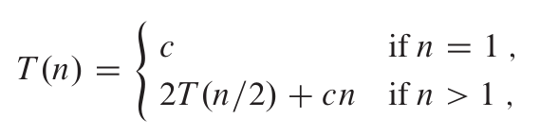
Merge Sort Time Complexity
Let T(n) be runtime for merge sort n numbers
sort an array with length one requires constant runtime
Partition to two subarray with length = n/2
Sort them recursively
merging two sorted array with length = n/2

Slide 52
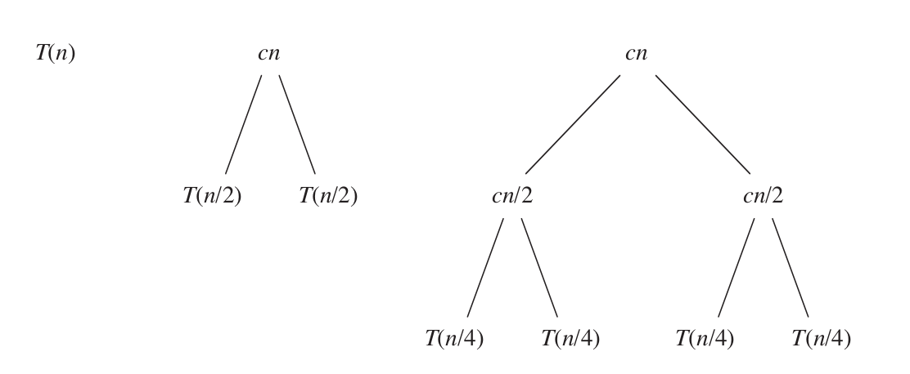
Merge Sort Time Complexity
Notes:
Recurrence tree from CLRS Fig 2.5

Slide 53
Merge Sort Time Complexity
Notes:
Recurrence tree from CLRS Fig 2.5

Slide 54
Merge Sort Time Complexity
Notes:
Recurrence tree from CLRS Fig 2.5

Slide 55
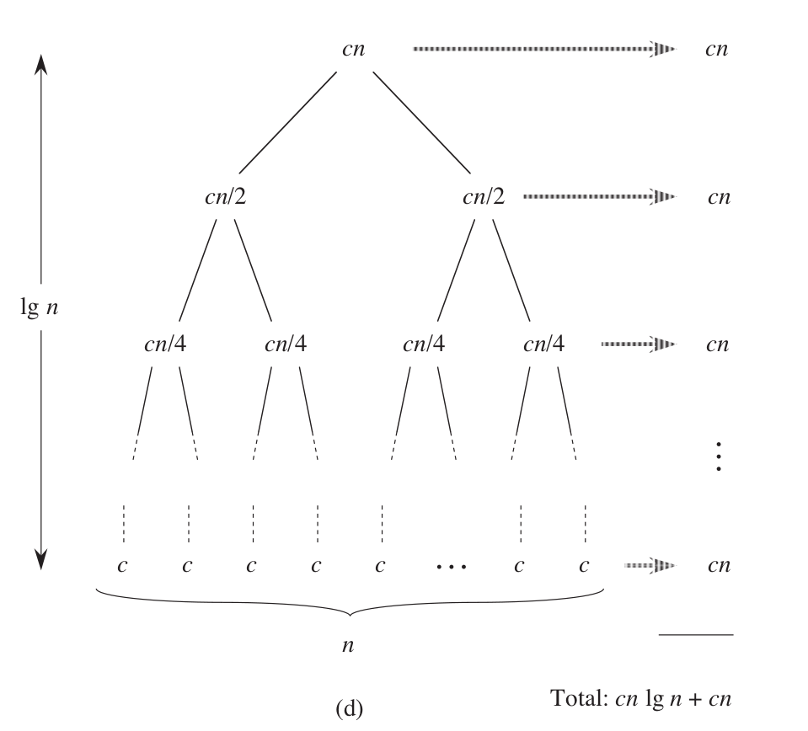
Merge Sort Time Complexity
In total cn * lg n = O(n lg n)
Notes:
Recurrence tree from CLRS Fig 2.5

Slide 56
Merge Sort
Recursively sort two subarrays
Merge two sorted subarrays
Time complexity: O(n lg n)
Recursion depth: O(lg n)
Merge: O(n)
1 2 2 3 4 5 6 7
O(n)
2 4 5 7
1 2 3 6
O(n)
O(lg n)
2 5
4 7
1 3
2 6
O(n)
5
2
4
7
1
3
2
6
O(n)

Slide 57
Merge Sort Implementation
using Iter = vector<int>::iterator;
void merge_sort(Iter L, Iter R) {
if (L+1 >= R) {
return;
} else {
Iter M = L + (R - L) / 2;
merge_sort(L, M);
merge_sort(M, R);
merge(L, M, R);
}
}
L
R
5 2 4 7 1 3 2 6
[L, R) be left-closed, right-open interval

Slide 58
Merge Sort Implementation
using Iter = vector<int>::iterator;
void merge_sort(Iter L, Iter R) {
if (L+1 >= R) {
return;
} else {
Iter M = L + (R - L) / 2;
merge_sort(L, M);
merge_sort(M, R);
merge(L, M, R);
}
}
Small sub-problem that is easy to solve

Slide 59
Merge Sort Implementation
using Iter = vector<int>::iterator;
void merge_sort(Iter L, Iter R) {
if (L+1 >= R) {
return;
} else {
Iter M = L + (R - L) / 2;
merge_sort(L, M);
merge_sort(M, R);
merge(L, M, R);
}
}
5 2 4 7 1 3 2 6
Divide
Conquer: solve sub-problems recursively
5 2 4 7
1 3 2 6

Slide 60
Merge Sort Implementation
using Iter = vector<int>::iterator;
void merge_sort(Iter L, Iter R) {
if (L+1 >= R) {
return;
} else {
Iter M = L + (R - L) / 2;
merge_sort(L, M);
merge_sort(M, R);
merge(L, M, R);
}
}
1 2 2 3 4 5 6 7
Conquer: merge sub-problems
2 4 5 7
1 2 3 6

Slide 61
Merge Sort Implementation
void merge(Iter L, Iter M, Iter R) {
static vector<int> buff;
buff.clear();
Iter i = L, j = M;
while (i != M && j != R) {
if (*i < *j) {
buff.emplace_back(*i), i++;
} else {
buff.emplace_back(*j), j++;
}
}
for (; i != M; i++) buff.emplace_back(*i);
for (; j != R; j++) buff.emplace_back(*j);
copy(buff.begin(), buff.end(), L);
}
L
M
R
1 2 2 3 4 5 6 7
2 4 5 7
1 2 3 6
L
M
R

Slide 62
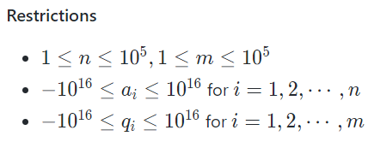
Binary Search Problem
Given a non-increasing integer array A with n integers.
Answer m queries.

Slide 63
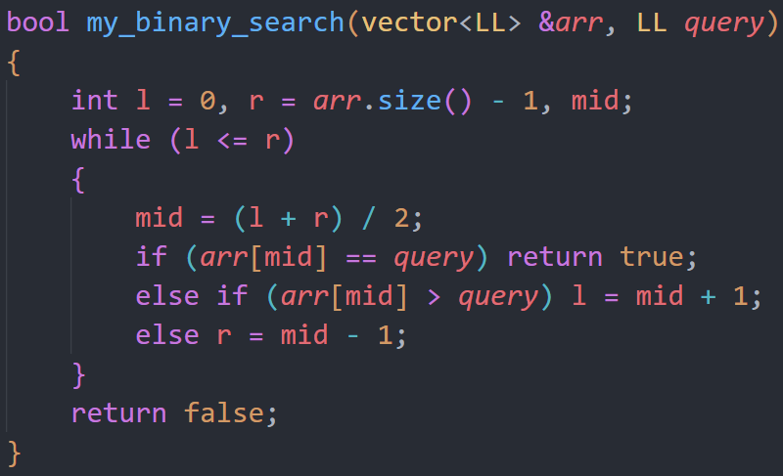
Binary Search (Implement)
L
MID
R
index | 0 | 1 | 2 | 3 | 4 | 5 | 6
value | 16 | 16 | 10 | 10 | 8 | 6 | 4

Slide 64
Binary Search (Implement)
L
MID
R
index | 0 | 1 | 2 | 3 | 4 | 5 | 6
value | 16 | 16 | 10 | 10 | 8 | 6 | 4

Slide 65
Class Implementation
Merge Sort:
http://codepad.org/4oql6nQx
Binary Search:
http://codepad.org/fgOrX8iK

Slide 66
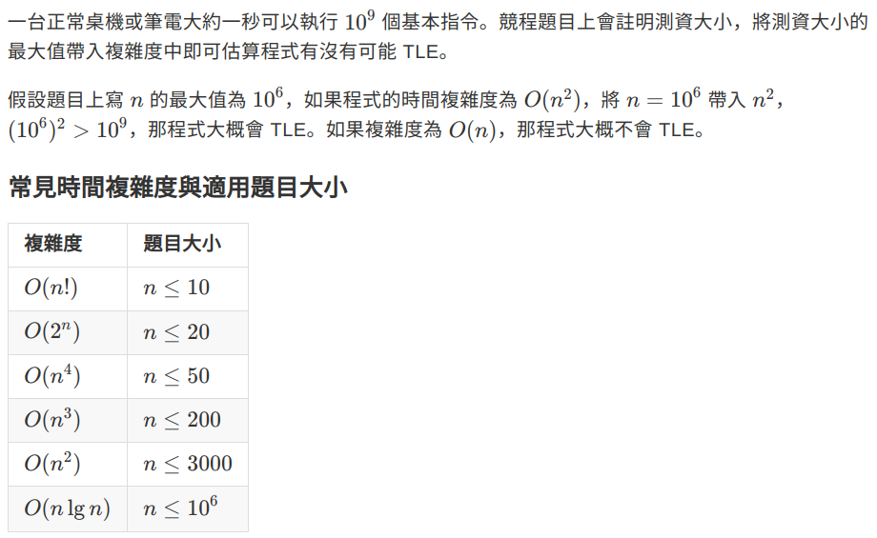
Time Complexity

